Slide 1


OLIST STORE-ANALYSIS
BY
GROUP 4

Slide 2
GROUp 4- MEMBERS
Yadu Krishnan A
Akhil Rajeev Nair
Yash Ajit Shinde
Kanajam Aparna.
Kumar Ashutosh

Slide 3
KEY PERFORMANCE INDICATORS
1)Weekday Vs Weekend (order purchase timestamp) Payment Statistics
2)Number of Orders with review score 5 and payment type as credit card.
3)Average number of days taken for order delivered customer date for pet shop
4)Average price and payment values from customers of Sao Paulo city
5)Relationship between shipping days (order delivered customer date – order purchase timestamp) Vs review scores.

Slide 4
KPI 1- Weekday Vs Weekend payment statistics
The Pie Chart shows Weekday vs Weekend payment statistics.
Total number of orders in weekday is 74,284
which is 77% of total order.
Total number of orders in weekend is 22,190
which is 23% of total order.

Slide 5
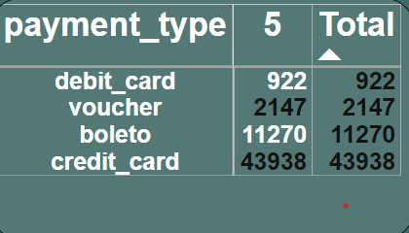
Kpi 2 - Number of Orders with review score 5 and payment type as credit card
The total number of orders with review score 5 and payment type as credit card is 43938.
Almost 58,277 orders with different payment types got review score 5.
A review score of 5 indicates a high level of customer satisfaction. By tracking the number of orders with this score, Olist can gauge the overall customer satisfaction level and identify areas where improvements needed.

Slide 6
Kpi 3-Average number of days taken for order delivered customer date for pet shop
Average number of days taken for order delivered customer date for pet shop 12.
A shorter delivery days can give the pet shop a competitive edge over other businesses.

Slide 7
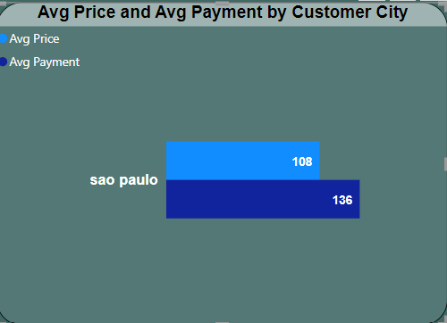
Kpi 4- Average price and payment values from customers of Sao Paulo city
Average price from customers of Sao paulo city is 108.
Average payment from customers of Sao paulo city is 136.

Slide 8
Kpi 5- Relationship between shipping days (order delivered customer date – order purchase timestamp) Vs review scores
Total of 99k orders were placed.
Average shipping days for review score 5 is 11.
Lowest average shipping days is 21.
The company should focus on minimizing shipping days to get customer satisfaction and to attract new customers.

Slide 9
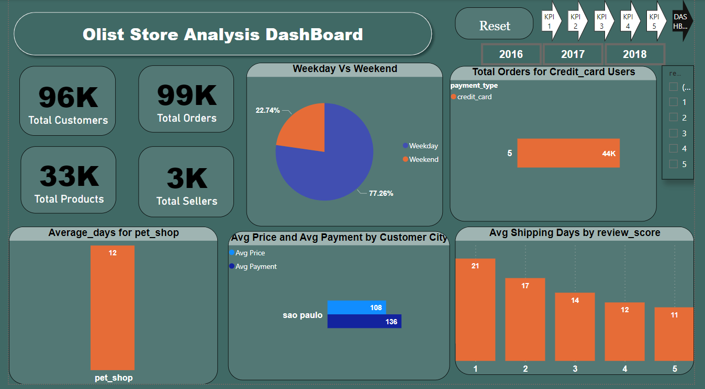
dashboard

Slide 10
CONCLUSION
Ongoing monitoring and analysis of this KPI’S helps to identify trends, seasonal variations, and areas that require further attention or improvement.
Olist store should focus more about shipping and delivering the products .

Slide 11
Thank you

